Slide 1









CLOUD IDENTITY
SUMMIT ‘24
Identity Security Track
Enrich Your Security with Automated Conditional Access Testing
Sander Rozemuller – YellowBlocks
Kenneth van Surksum – Secure At Work
Community Event by
Gold Sponsors
Bronze
Sponsor

Slide 2

CLOUD IDENTITY
SUMMIT ‘24
Thanks to our sponsors
Gold Sponsors
Bronze Sponsors

Slide 3

CLOUD IDENTITY
SUMMIT ‘24
Thanks to our sponsors
Gold Sponsors
Bronze Sponsors

Slide 4
About// Cloud Identity Summit – Hybrid Cloud Identity Conference
Title: Enrich Your Security with Automated Conditional Access Testing
Abstract: Unlock the full potential of your security posture with an innovative session led by experts Sander Rozemuller and Kenneth van Surksum. Discover how automating your Conditional Access testing not only streamlines your security processes but also ensures that your defences are always up to date and effective. Join us to revolutionize how you manage and secure your digital environment. This session is your key to unlocking a more secure, efficient, and resilient future.
Date: Thursday September 5th
Location: Köln
Time: 9:50 - 10:40 (50 minutes)

Slide 5
Hotel and Venue
Location
The conference will take place on 05/09/24 at Microsoft Office Cologne between 08:30 AM (doors open) to 5:30 PM.
Address: Holzmarkt 2, 50676 Köln, Germany
Parking: There is a park and ride parking spot under the Severinsbridge (in walking distance to the art`otel and Microsoft office) for 5€ per day. Parking is also available at the Hotels Premier Inn and Art`otel but with expensive prices.
Please let us know if you arrive by car, so that we can check if there's an option to arrange a slot in the venue parking garage.
Hotel
We have booked an overnight stay for you (04/09/ - 05/09/24) at the Hotel "art'otel Cologne" which is in walking distance to the conference location (3 minutes' walk) and close to the Rhine promenaide.
Just check-in with your name and reference to the Cloud Identity Summit at hotel reception. The costs (for one night) will be covered by us.
As many speakers will go to the event venue early in the morning, we have booked rooms without breakfast. If you want to have breakfast at the hotel, please book this on charge of your room. The costs will be also covered by us.
At the venue we offer the following light breakfast:
• Bread rools with different flavors (also vegetarian), coffee, tea & soda drinks
• We have book also a great meal for lunch ;)
Speaker Dinner and City Infos
The speaker's dinner will take place on September 4th and will start at 6 pm. We will provide more information soon. For those one who will visit Cologne for the very first time: Make sure you have some free time on your trip, to have a walk from the central station along the rhine to the venue. This gives you a nice impression of the city and the option to visit the cathedral in walking distance to the central station.

Slide 6
Presentation Layout
Why test?
Default options (Kenneth)
Testing manually
Sign-in logs (filtering)
Workbooks (LA logging necessary)
GAP Analysis
What if tooling
Automation (Sander)
How? (by targeting the whatif api?)
Set it up yourself (some examples)
Frameworks (maester?)
Wrap up (Kenneth & Sander)

Slide 7
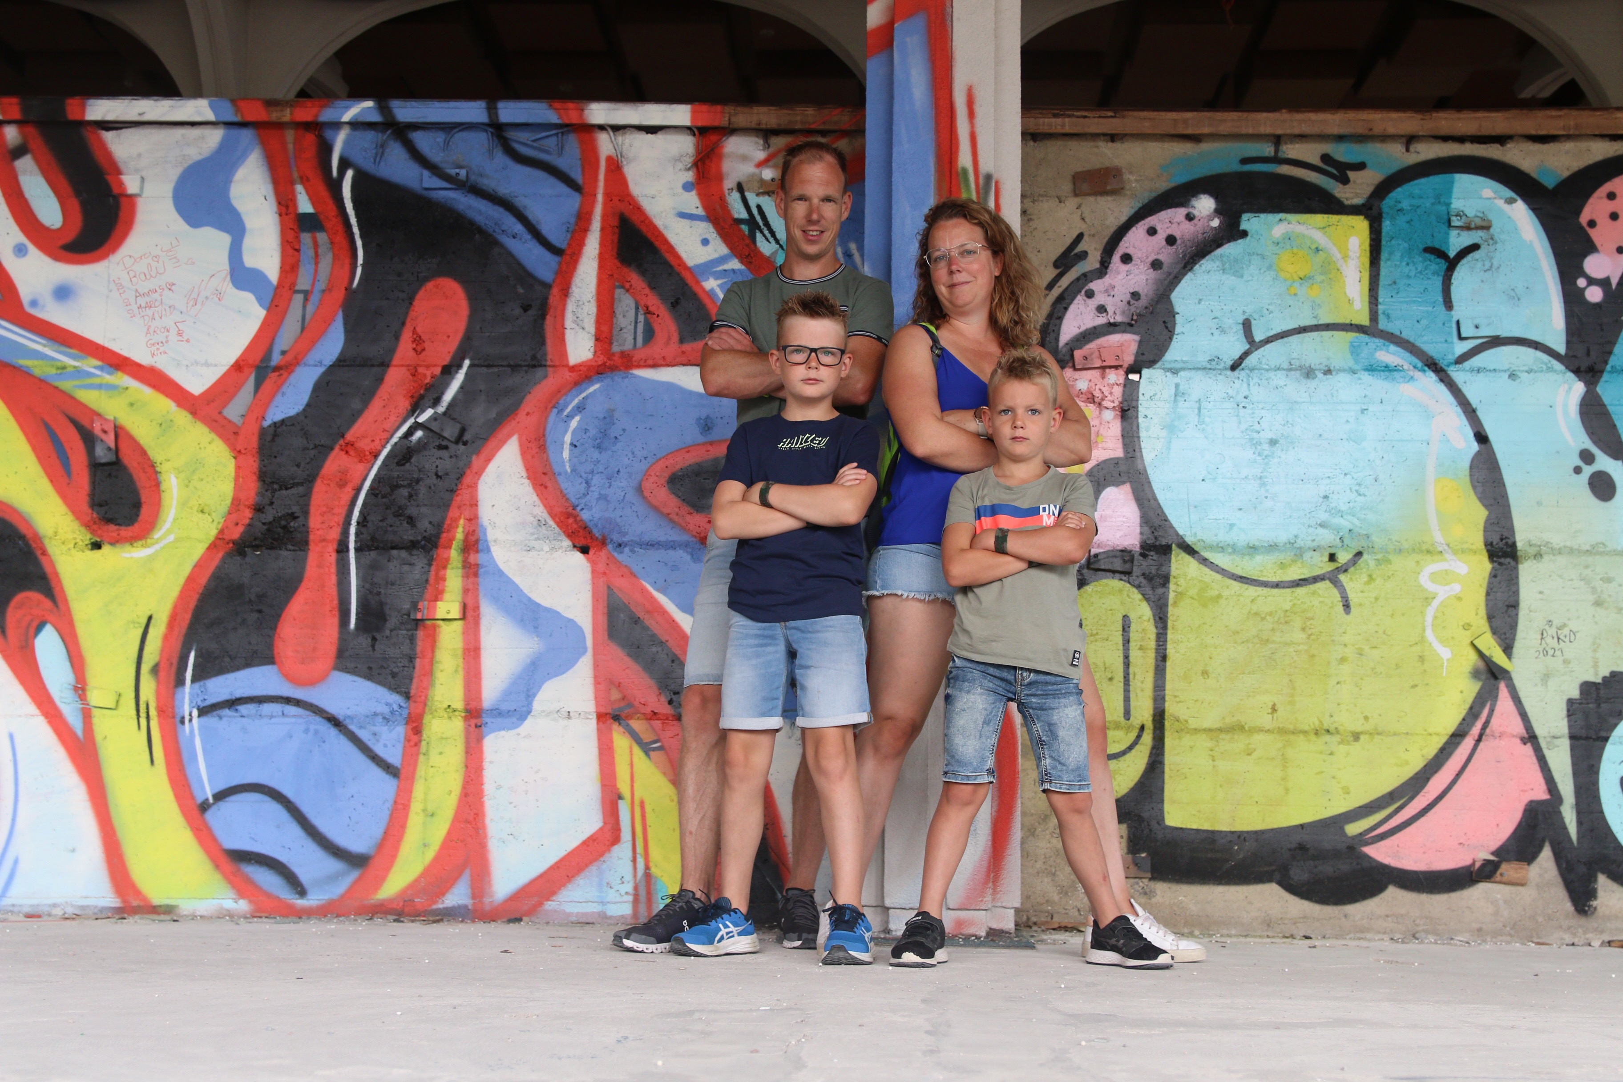



Sander Rozemuller
Creative freelance cloud developer
Member of Dutch WP Ninja User Group
Microsoft MVP
Microsoft Intune & AVD
Focus on: automation, identity & modern work

Slide 8
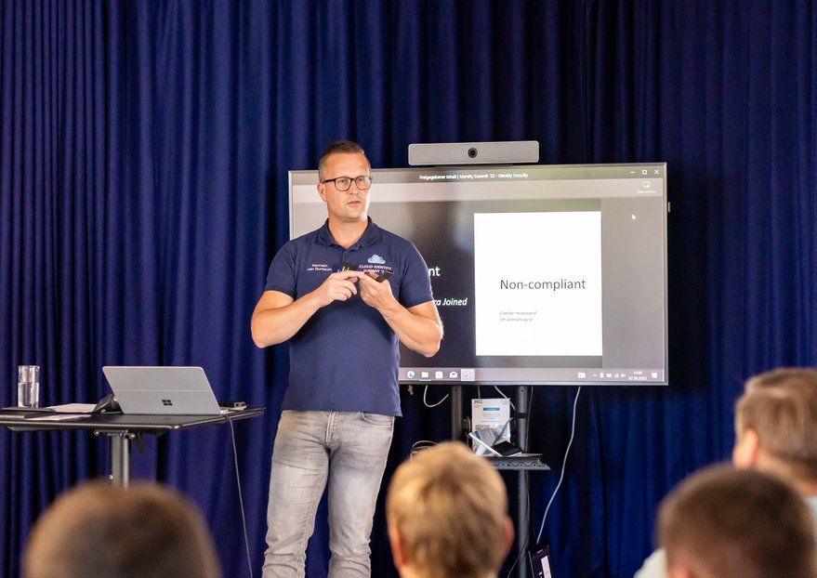



About: Kenneth van Surksum
Modern Workplace Consultant at Secure At Work
Microsoft MVP Identity and Access & Microsoft Intune
Founding Member of Workplace Ninja User Group Netherlands
Speaker manager for ExpertsLive Netherlands

Slide 9
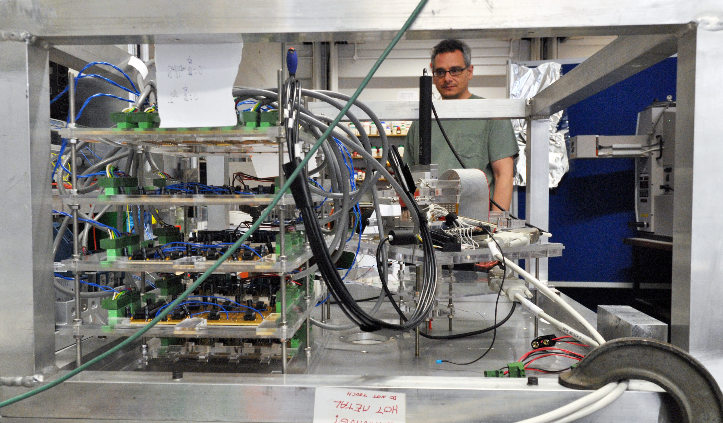
Why test?
This Photo by Unknown Author is licensed under CC BY
Notes:
Complex, monitoring & alerting missing

Slide 10

Demo: Manual test options
Let’s validate whether your Conditional Access policies are doing what they are supposed to do
Notes:
Kenneth:
Prerequisites:
Browser window, logged in as admin-kenneth@itgration.onmicrosoft.com
Browse to: https://entra.microsoft.com
Step 1: Show Conditional Access policies
Browse to Conditional Access policies, and explain their setup
Step 2: Browse to Sign-in logs
Explain that we now have interactive sign-ins/non-interactive sign-ins, service principal sign-ins and Managed identity sign-ins
Show that we can modify the view, by selecting Columns
Show that we can filter, by adding a filter on Conditional Access = Not applied
Explain that the sign-ins which have Windows Sign In, or Microsoft Authentication Broker are expected to not have Conditional Access applied
Modify the filter back to "Success"
Click on one of the sign-ins and show the Conditional Access and Report-Only tabs
Click-through by selecting one of the CA policies and show why it was successful or failing
Explain that sign-in logs are only available for 1 month, and it's therefore advised to keep them longer. We can achieve this by storing the sign-in logs in a Log Analytics workspace
Step 3: Show Log Analytics Workspace forwarding
Browse to Monitoring & Health -> Diagnostic settings
Explain that forwarding is configured here, and click on the la-SecurityLogging workspace
Click on "Manage Costs" and show that you can tweak Data Retention also tell that you can tweak individual tables (f.e. non-interactive sign-ins)
Step 4: Show Workbooks
Browse to Monitoring & Health -> Workbooks
Show the Conditional Access insights and reporting workbook
Show the Conditional Access Gap Analyzer workbook
Step 5: Show What if tooling
Return to Conditional Access, select policies
Select What if
Select User or Workload identity -> and select Ferry Kuhlman
Select Cloud apps, actions, or authentication context -> Select Office 365
Show results of What if…

Slide 11

Automation
Let’s automate it!
This Photo by Unknown Author is licensed under CC BY-NC-ND

Slide 12
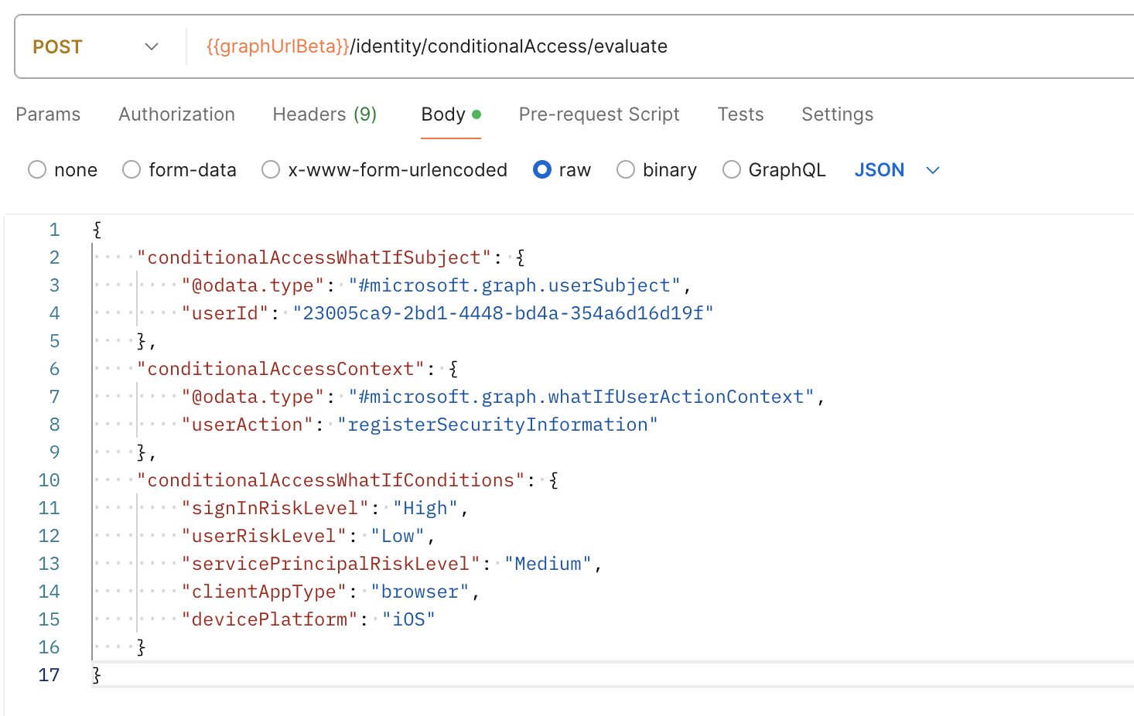
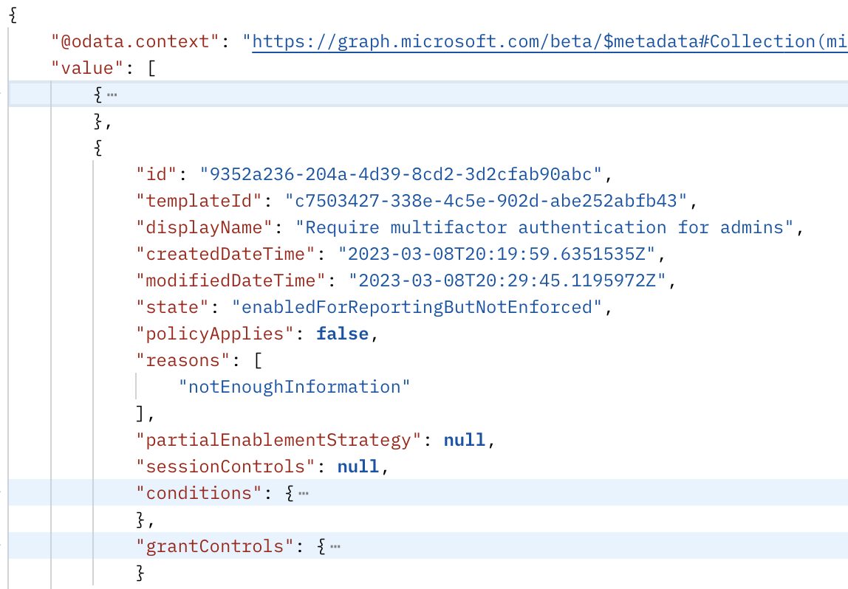
Automated testing with Graph

Slide 13
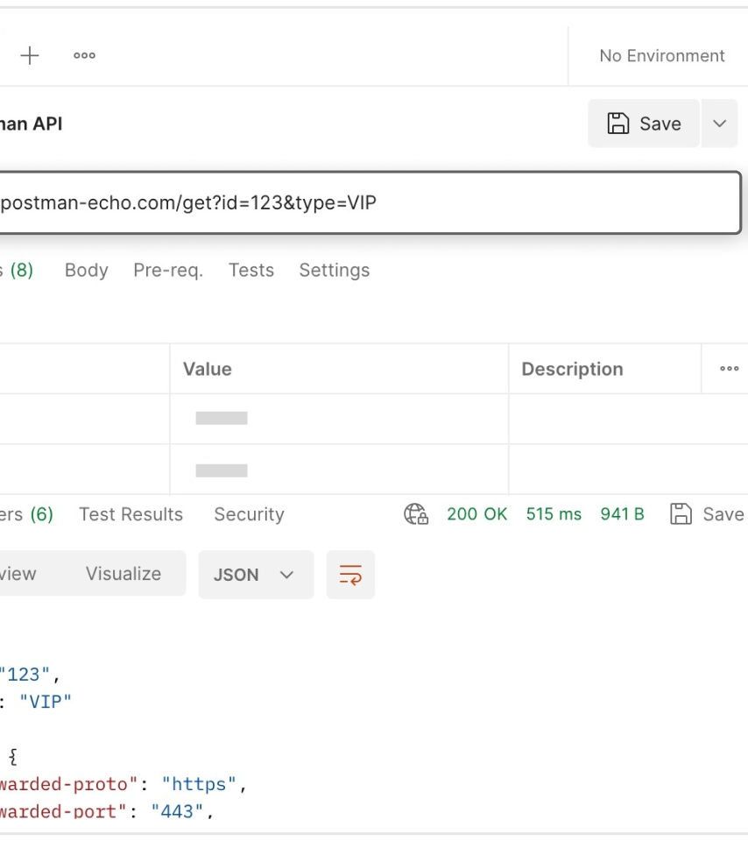
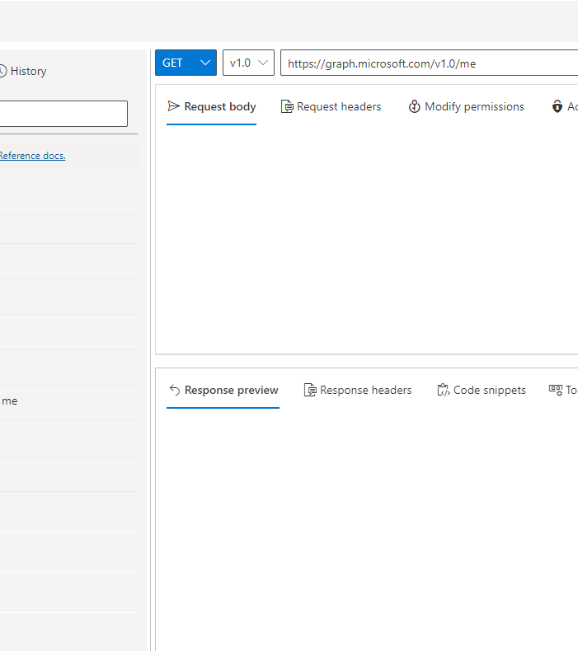
Demo
Test with Postman/Graph Explorer
Notes:
Step 1: Show what if option from automation perspective
WhatIf option explained from automation perspective, show example through the portal with developer tab open.
Determine that there is an internal URL used, but there is an endpoint available
Step 2: Show there is a Graph endpoint available, but not documented
https://graph.microsoft.com/beta/identity/conditionalAccess/evaluate
Show graph explorer, consent and show example with body content
Show same but then using Postman. This because of several examples
Step 3: show blog post
https://rozemuller.com/check-conditional-access-policy-effect-automated/
Have written a blog post on how to test scenario's

Slide 14


Maester
Test your Microsoft365 configuration using Pester and Maester.

Slide 15
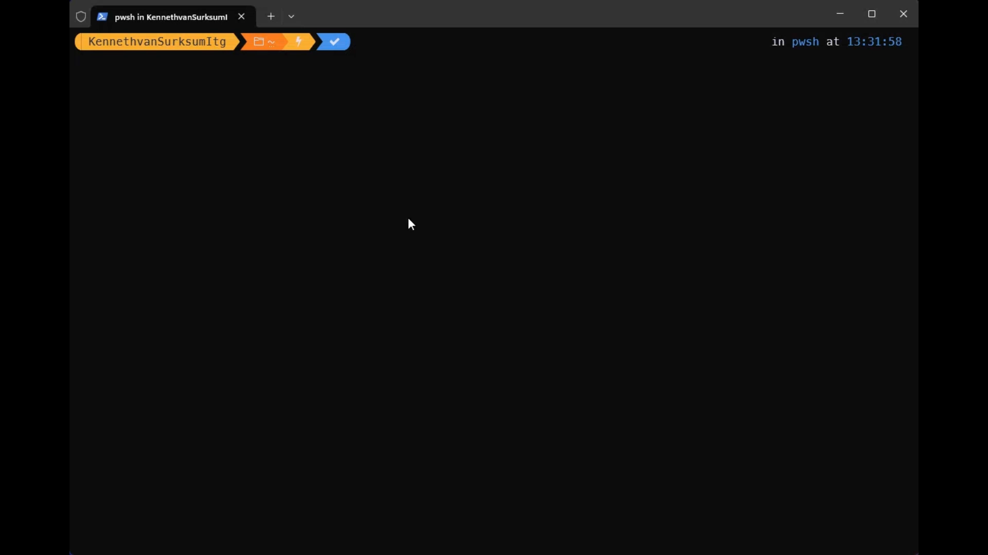

Slide 16
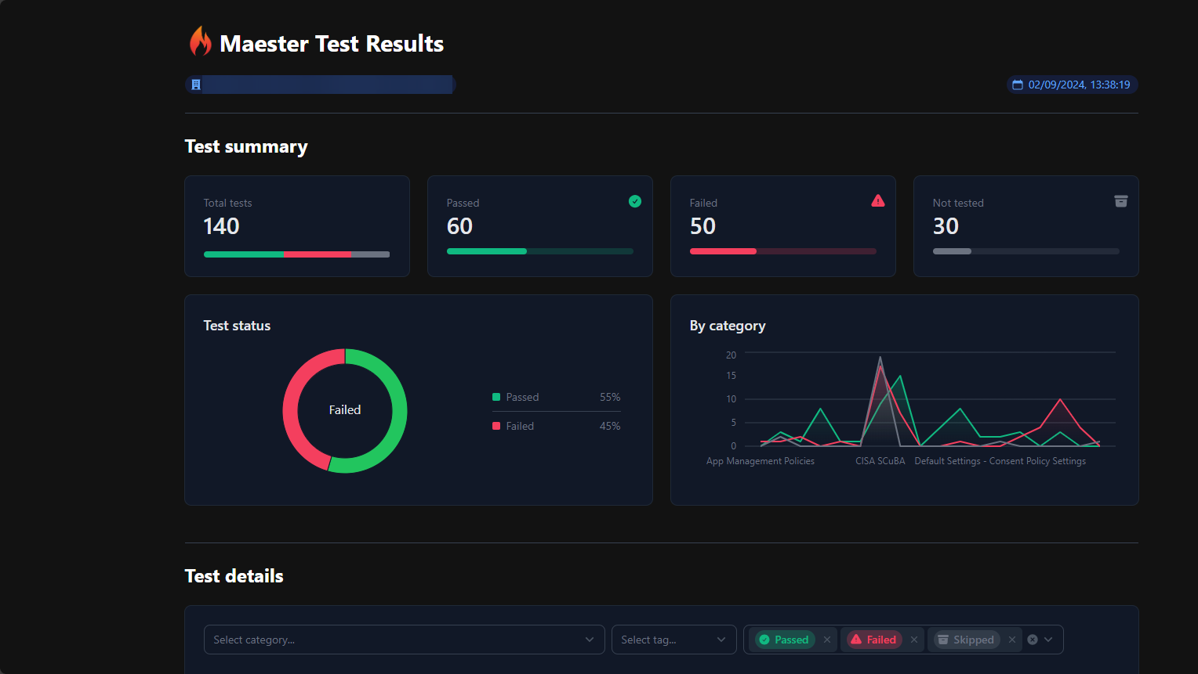

Slide 17
Demo
Maester

Slide 18

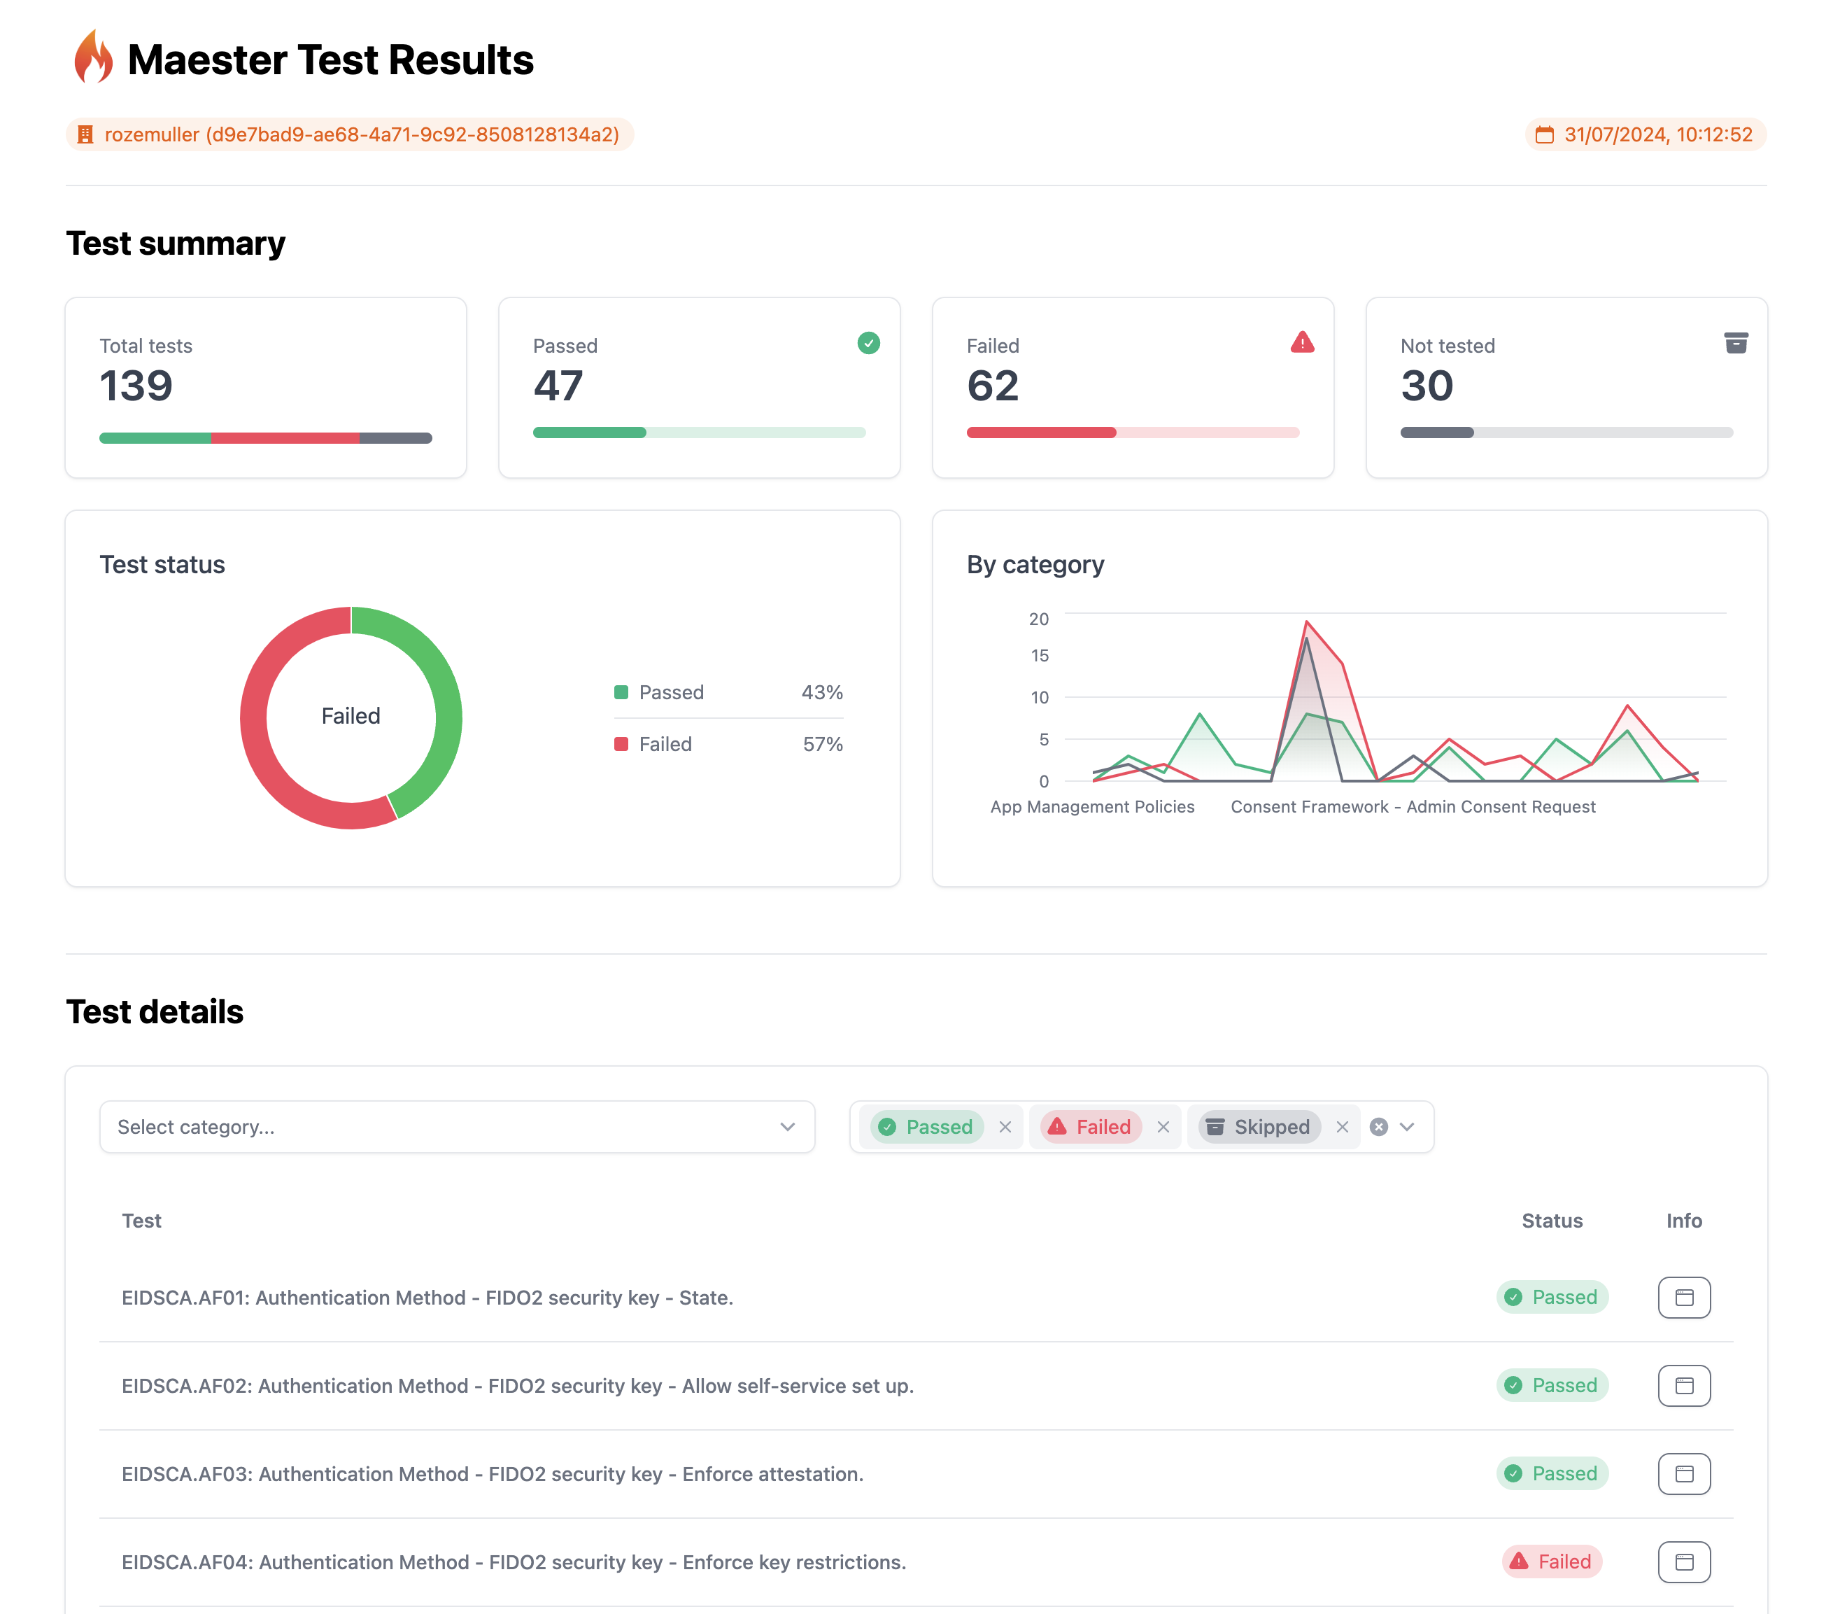
Maester
How to set up
Local / PowerShell
GitHub Actions

Slide 19
Monitoring, Alert & follow-up
Results, and now?
Log Analytics - > Azure Sentinel
Notes:
Log analytics - > Create Table
DCR Rule -> Monitor Metric publisher permissions IAM
Azure monitor -> data collection endpoint

Slide 20
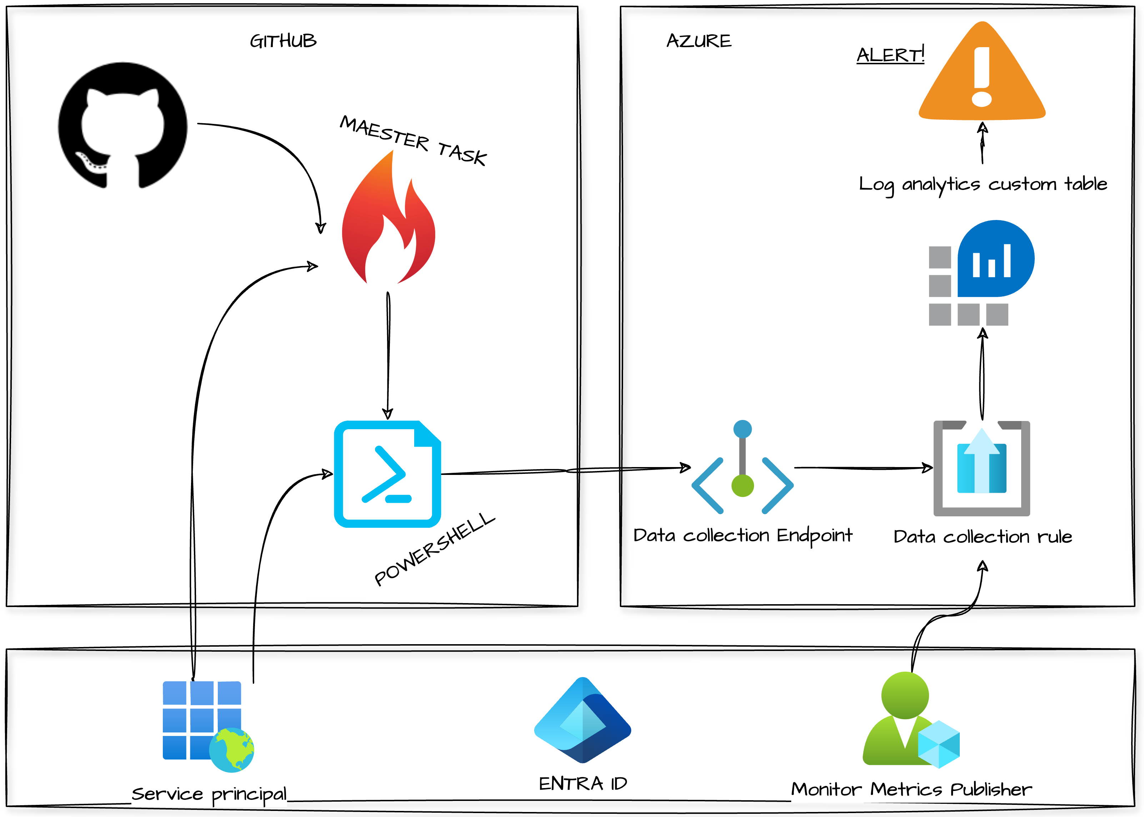
Testing platform
GitHub Actions
Azure
Entra ID

Slide 21
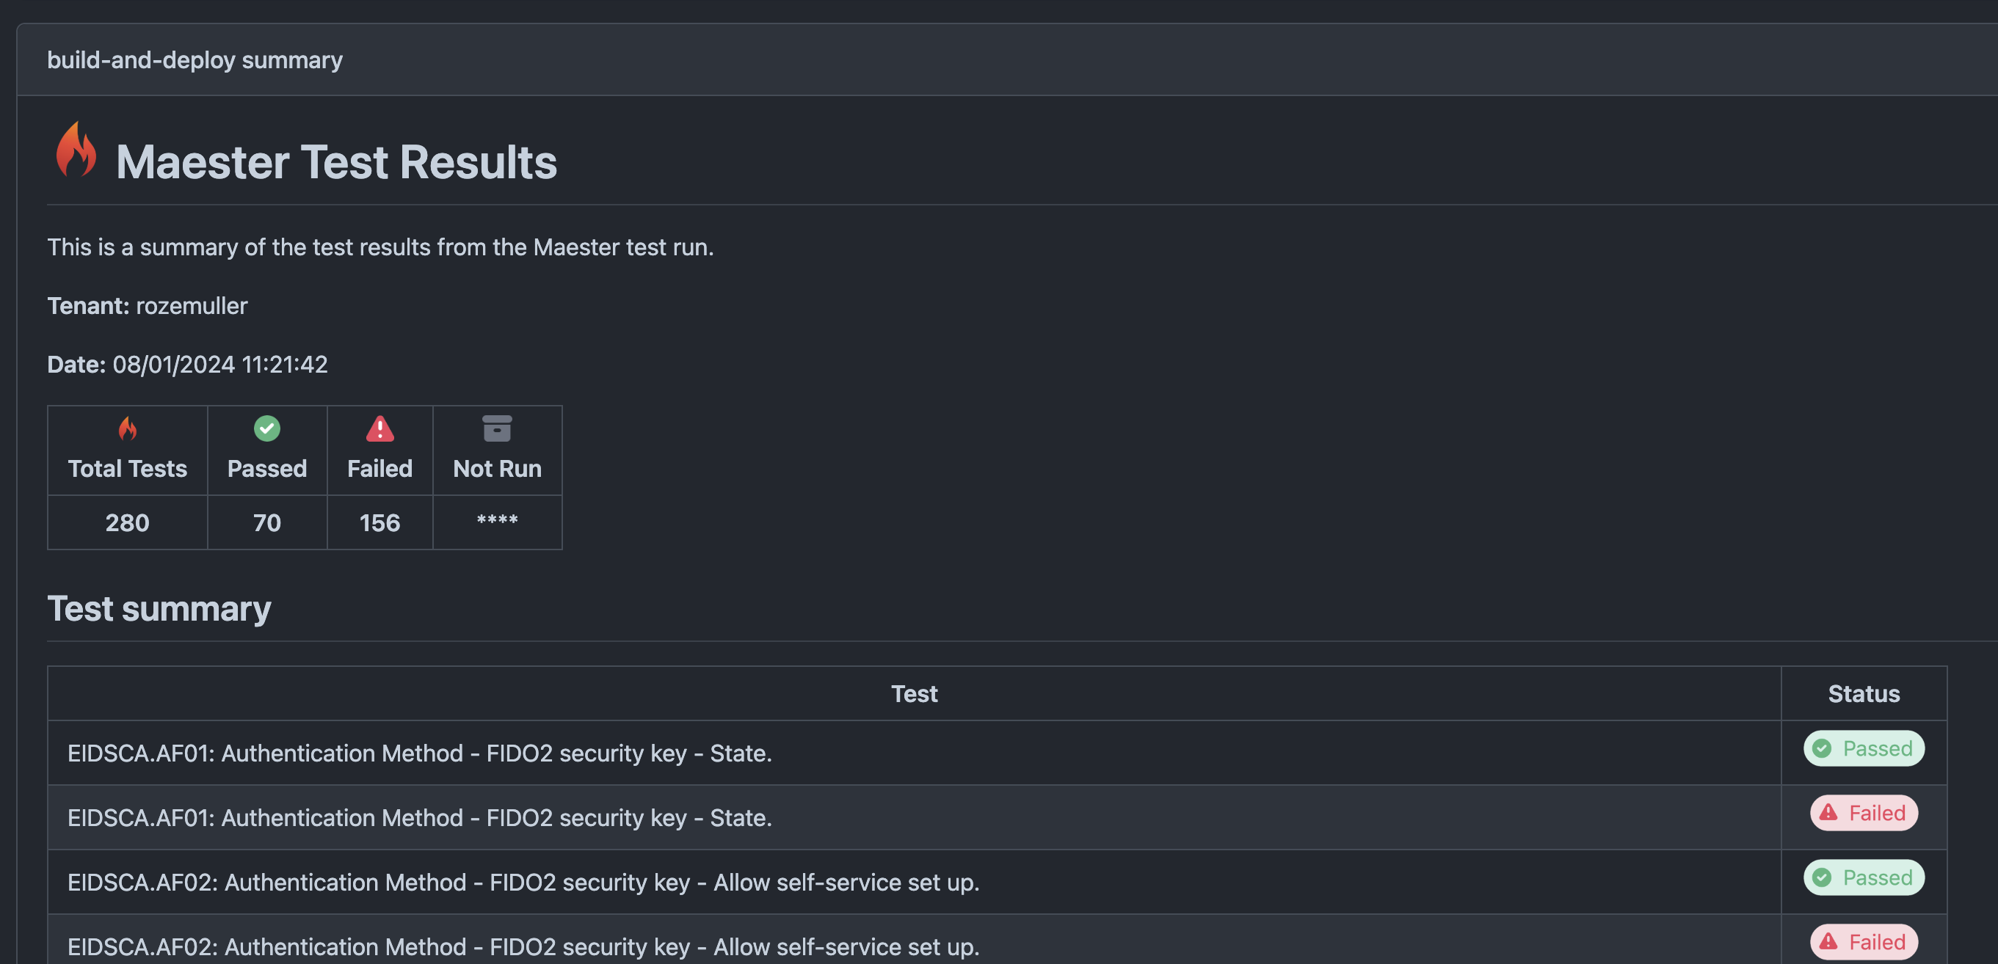
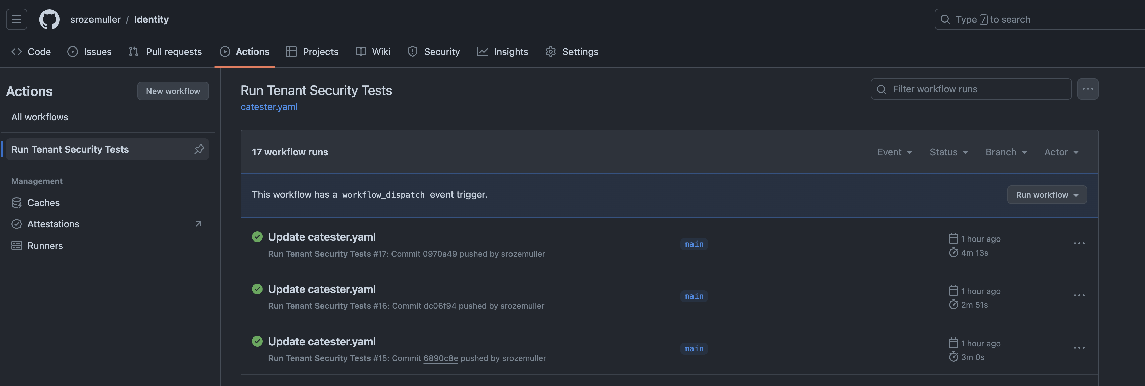
GitHub Actions

Slide 22
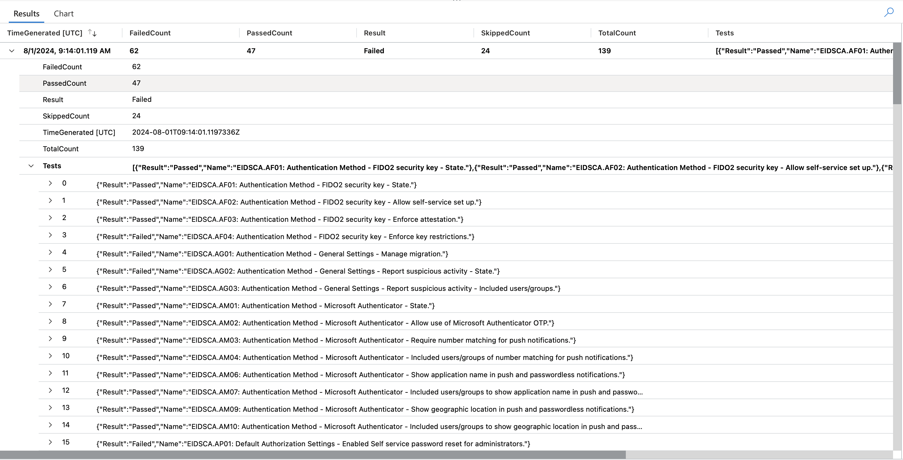
Log results

Slide 23
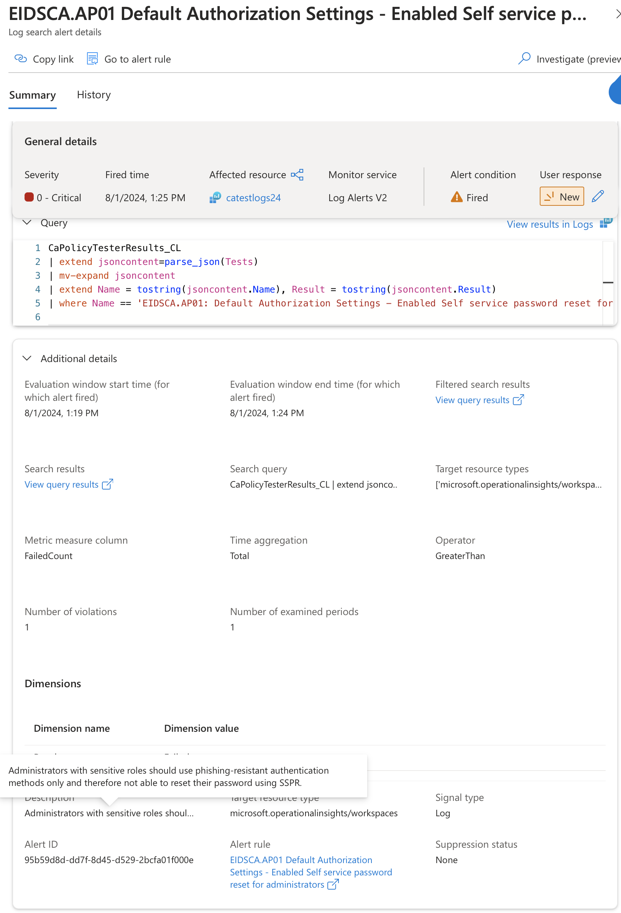
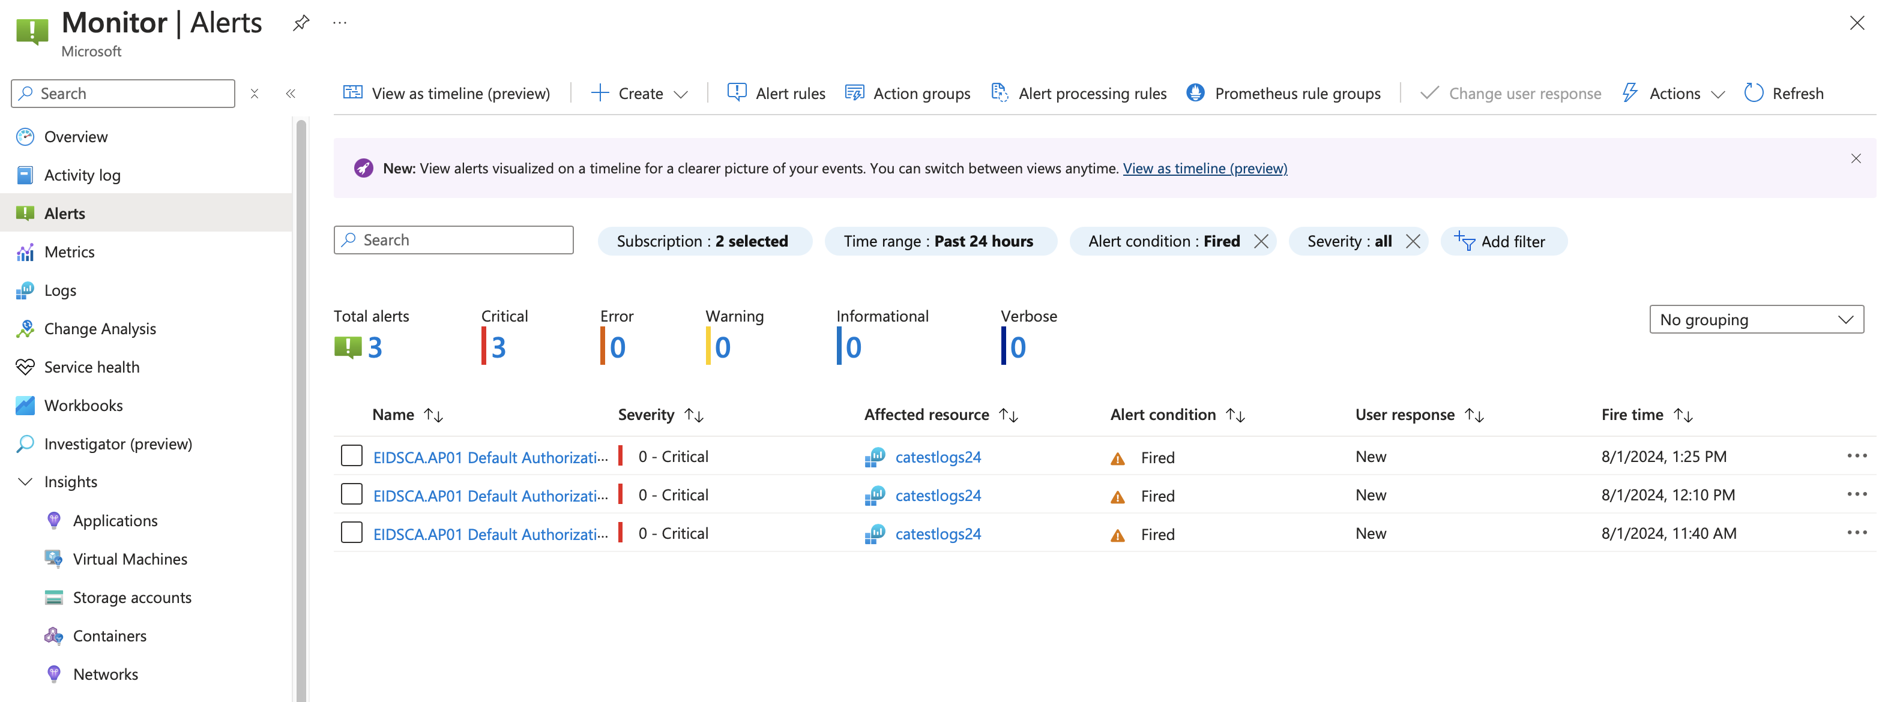
Alerts

Slide 24
Demo monitoring
Maester
Notes:
Step 1: Show Github
Show how to set up GitHub action
Show how to connect repository to azure tenant using federated credentials
Show identity that is use in the tenant
Show Maester task in the Github action (action is in identity repository)
Show PowerShell task that fetches the Maester output and send the info to log analytics
Step 2: Show Azure configuration
Show how to setup log analytics
Show data collection endpoint (this is the frontdoor)
Show data collection rule (responsible to send the data to the correct location) Like in the past a telephone operator did
Show IAM Monitor publisher role for service principal on the collection rule
Show custom table in log analytics
Show how to create kusto query
Show monitor rule to send alerts
Step 3: Show in action
Run the github action

Slide 25
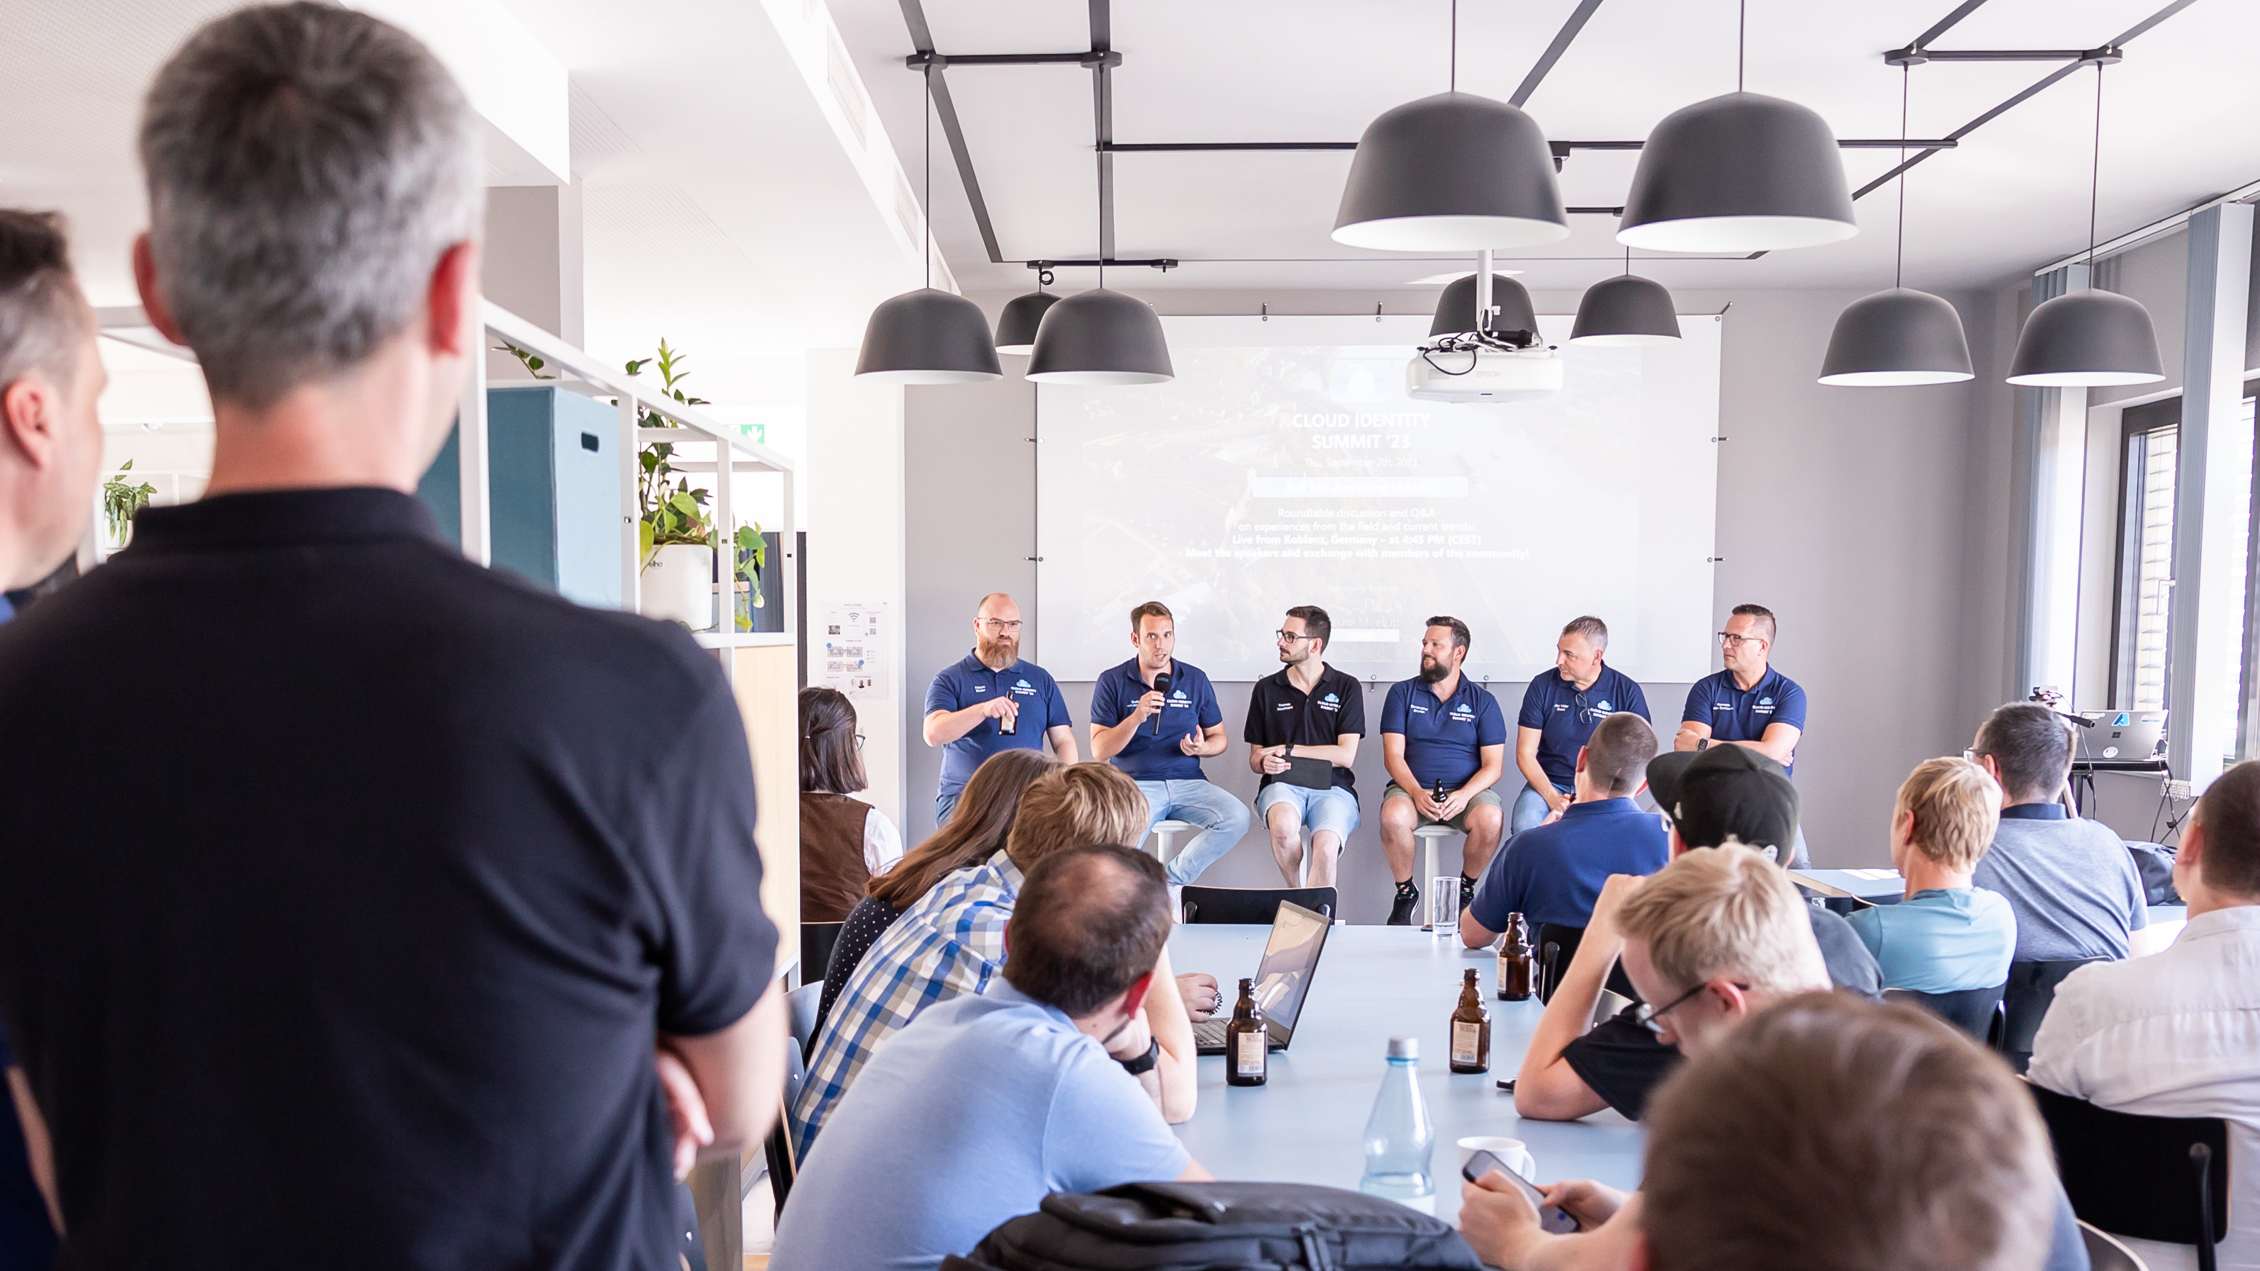
CLOUD IDENTITY
SUMMIT ‘24
Ask Me Anything (AMA)
Roundtable discussion and Q&A​
on experiences from the field and current trends!​
Meet the speakers and exchange with members of the community!​
4:40 PM @5th Floor
Bronze Sponsors
Community Event by

Slide 26
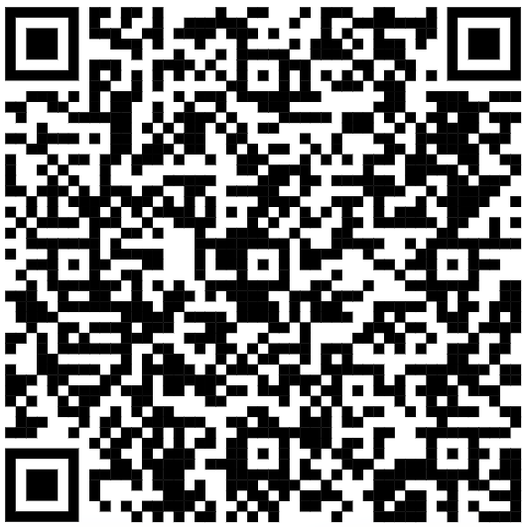
Thank you
GitHub location for slide deck, workflow and detailed info

Slide 27
CLOUD IDENTITY
SUMMIT ‘24
Your Feedback is Important!
https://www.identitysummit.cloud/feedback/
Community Event by

